Slide 1
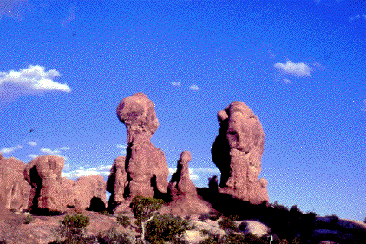
Weathering and Erosion

Slide 2
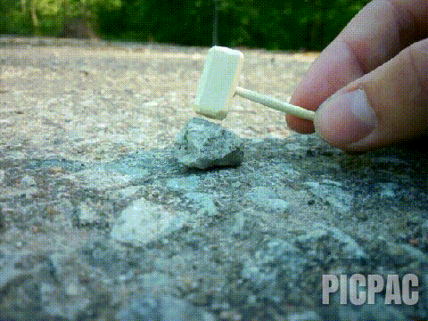
Weathering means the process of breaking down rocks and other substances at Earth’s surface.

Slide 3
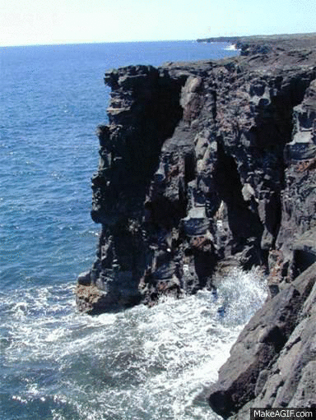
Erosion means the movement of rock particles by wind, water, ice, or gravity.

Slide 4
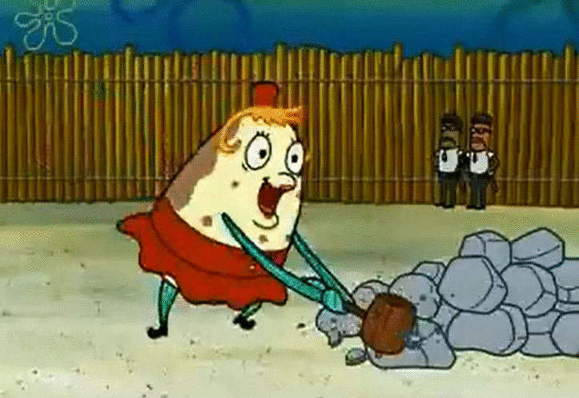
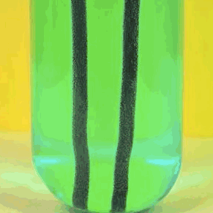
Two Types OF Weathering:
Mechanical (Physical) Weathering is
When rock is physically broken into
smaller pieces (but still
have the same chemical composition).
Chemical weathering is
Breaking down rocks through chemical changes

Slide 5
There are 5 Types of Mechanical Weathering
Freezing and Thawing
Release of Pressure
Growth of Plants
Actions of Animals
Abrasion

Slide 6
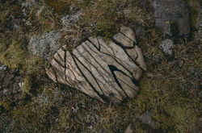
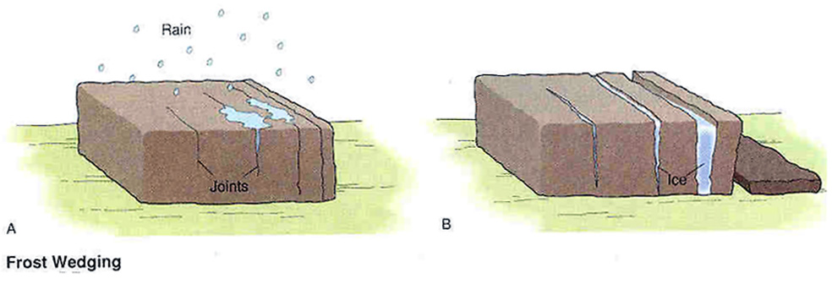
Freezing and thawing of water.
(Ice Wedging)-
Water seeps into cracks in rocks and then freezes when the temperature drops. It expands when it freezes and acts like a wedge.

Slide 7
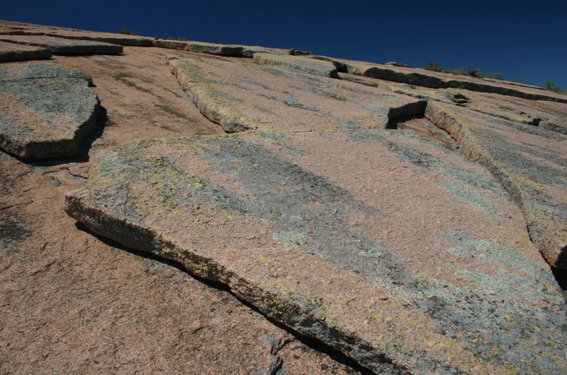
Release of pressure
1. Erosion carries away rocks from the top of a mountain. This reduces pressure on the rocks below and causes the outside rocks to crack and flake off like layers of an onion.

Slide 8
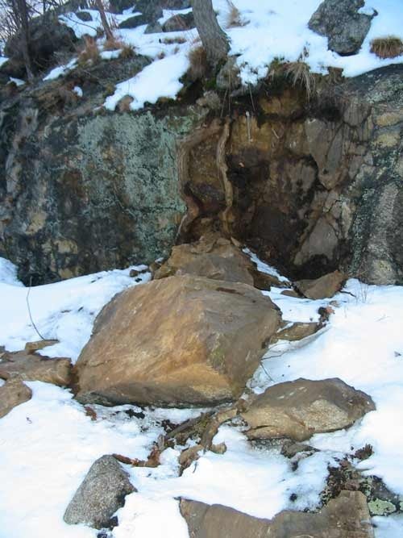
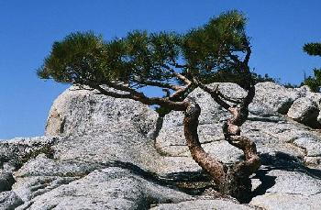
Plant action-
Plant roots grow in cracks of rocks and pry rocks apart.

Slide 9
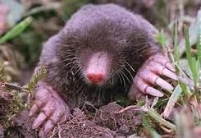
Actions of Animals
Animals burrow in the ground and break apart rocks.

Slide 10
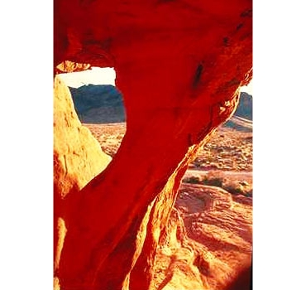
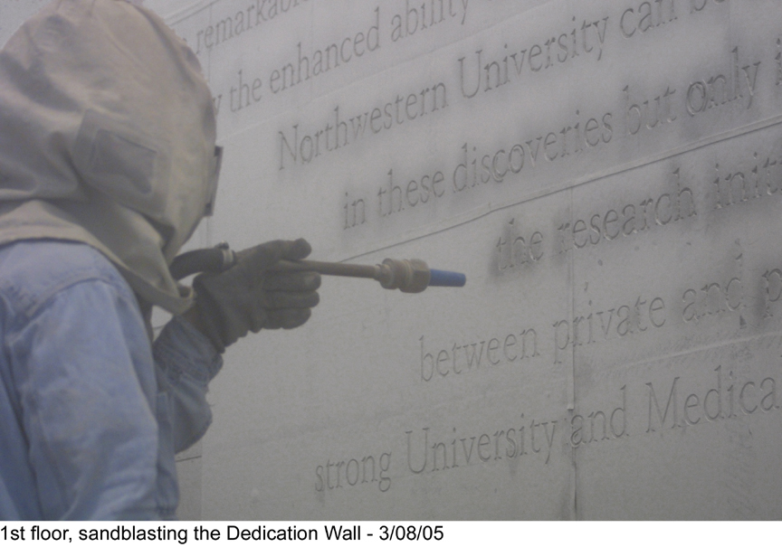
Abrasion- rubbing by other rocks.
Sand and other rock particles carried by wind, water, ice, or gravity wear away rocks.

Slide 11
Types of Chemical Weathering
Water
Oxygen (Rust)
CO2
Living Organisms
Acid Rain

Slide 12
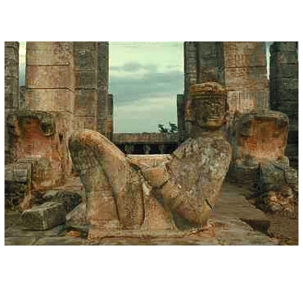
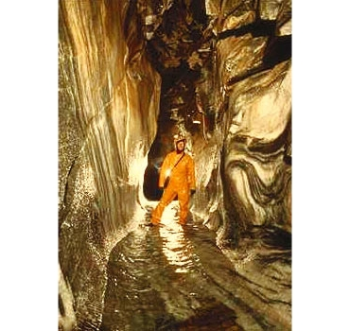
Water
Minerals are dissolved in water.
ex.: Halite, calcite

Slide 13
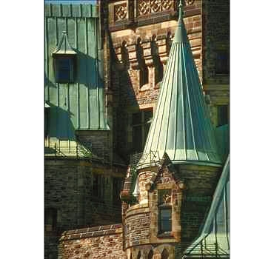
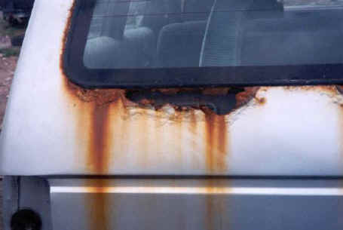
Oxidation-
Oxygen combines with water to make rust. (Oxidation)
ex.: rusty bicycle

Slide 14
CO2
Carbon dioxide dissolves in rainwater to make carbonic acid (weathers marble and limestone).

Slide 15
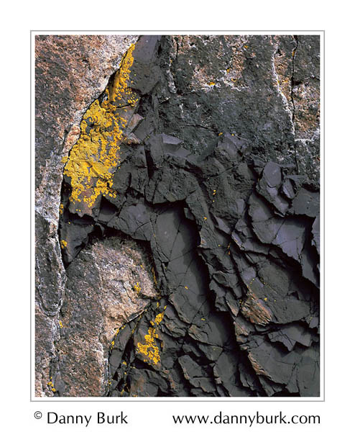
Living Organisms
Plant roots produce weak acids that dissolve rocks. Lichens grow on rocks and make weak acids.

Slide 16
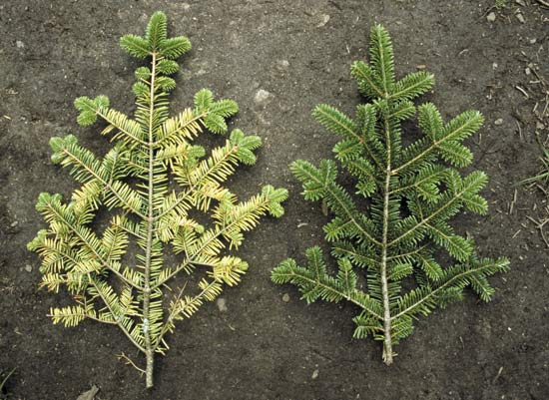
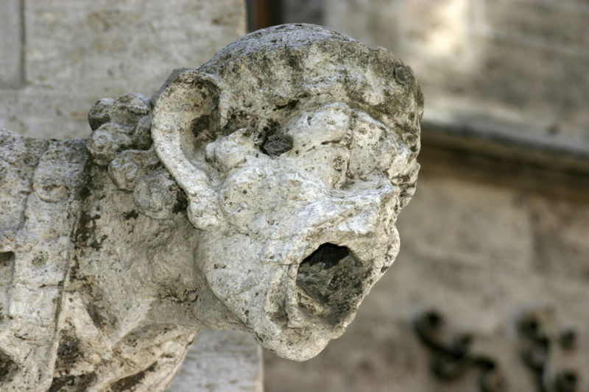
Acid Rain:
Burning fossil fuels causes sulfur, carbon, and nitrogen to mix with water vapor in clouds to make acid rain.

Slide 17
Rates of Weathering will depend on:
Surface area exposed - More surface exposed, the faster the weathering will occur.

Slide 18
Rates of Weathering will depend on:
Type of Rock - some rocks and minerals are more resistant than others.
ex.:Quartz is resistant to chemical and physical weathering. Slate tombstones weather slower than marble tombstones.

Slide 19
Rates of Weathering will depend on:
Climate:
Cold and/or dry climates favor physical weathering.
Warm and wet climates favor chemical weathering.

