Slide 1
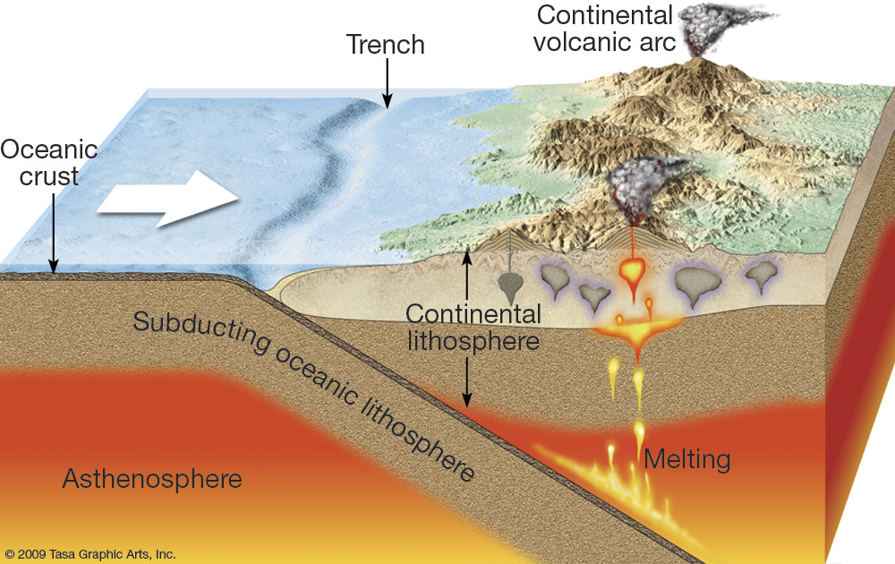
Convergent Boundaries
When two tectonic plates collide, the boundary between them is a convergent boundary. What happens at a convergent boundary depends on the kind of crust at the leading edge of each tectonic plate. The three types of convergent boundaries are continental-continental boundaries, continental-oceanic boundaries, and oceanic-oceanic boundaries.

Slide 2
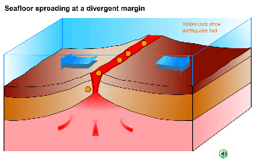
Divergent Boundaries
When two tectonic plates separate, the boundary between them is called a divergent boundary. New sea floor forms at divergent boundaries. Mid-ocean ridges are the most common type of divergent boundary.

Slide 3
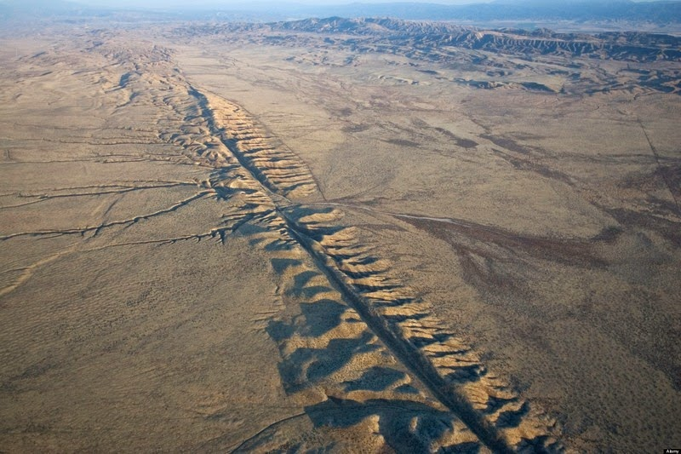
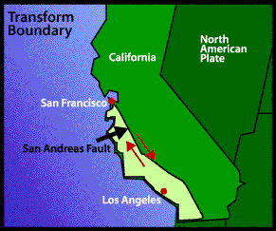
Transform Boundaries
When two tectonic plates slide past each other horizontally, the boundary between them is a transform boundary. The San Andreas Fault in California is a good example of a transform boundary. This fault marks the place where the Pacific and North American plates are sliding past each other.

Slide 4
Transform Boundary

Slide 5
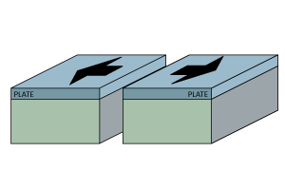
Divergent Boundary

Slide 6
Convergent Boundary

