Slide 1
Introduce

Slide 2
Measuring in space
Light Year – Distance light travels through space in one year
About 300,000 km/s
Or 9.5 trillion km/year
Astronomical Units (AU)
Distance from Earth to the sun
Which is about 150 million km.

Slide 3
Solar system
A solar system is a collection of large and small bodies that orbit our central star, the sun.
Within our solar system are planets.
Planets are spherical bodies that orbit the sun that are larger than the other bodies that are in our solar system.

Slide 4
Solar system
Orbiting most of our planets are smaller bodies called moons.
The rest of our solar system is made up of other small bodies that include:
dwarf planets
Comets
Asteroids
Meteroids
There are up to a trillion small bodies in the solar system.

Slide 5
Stars
A star is a celestial body that is composed of gas and emits light.
Most are made of hydrogen and helium
Stars create energy through nuclear fusion
This energy is released as light and radiation

Slide 6
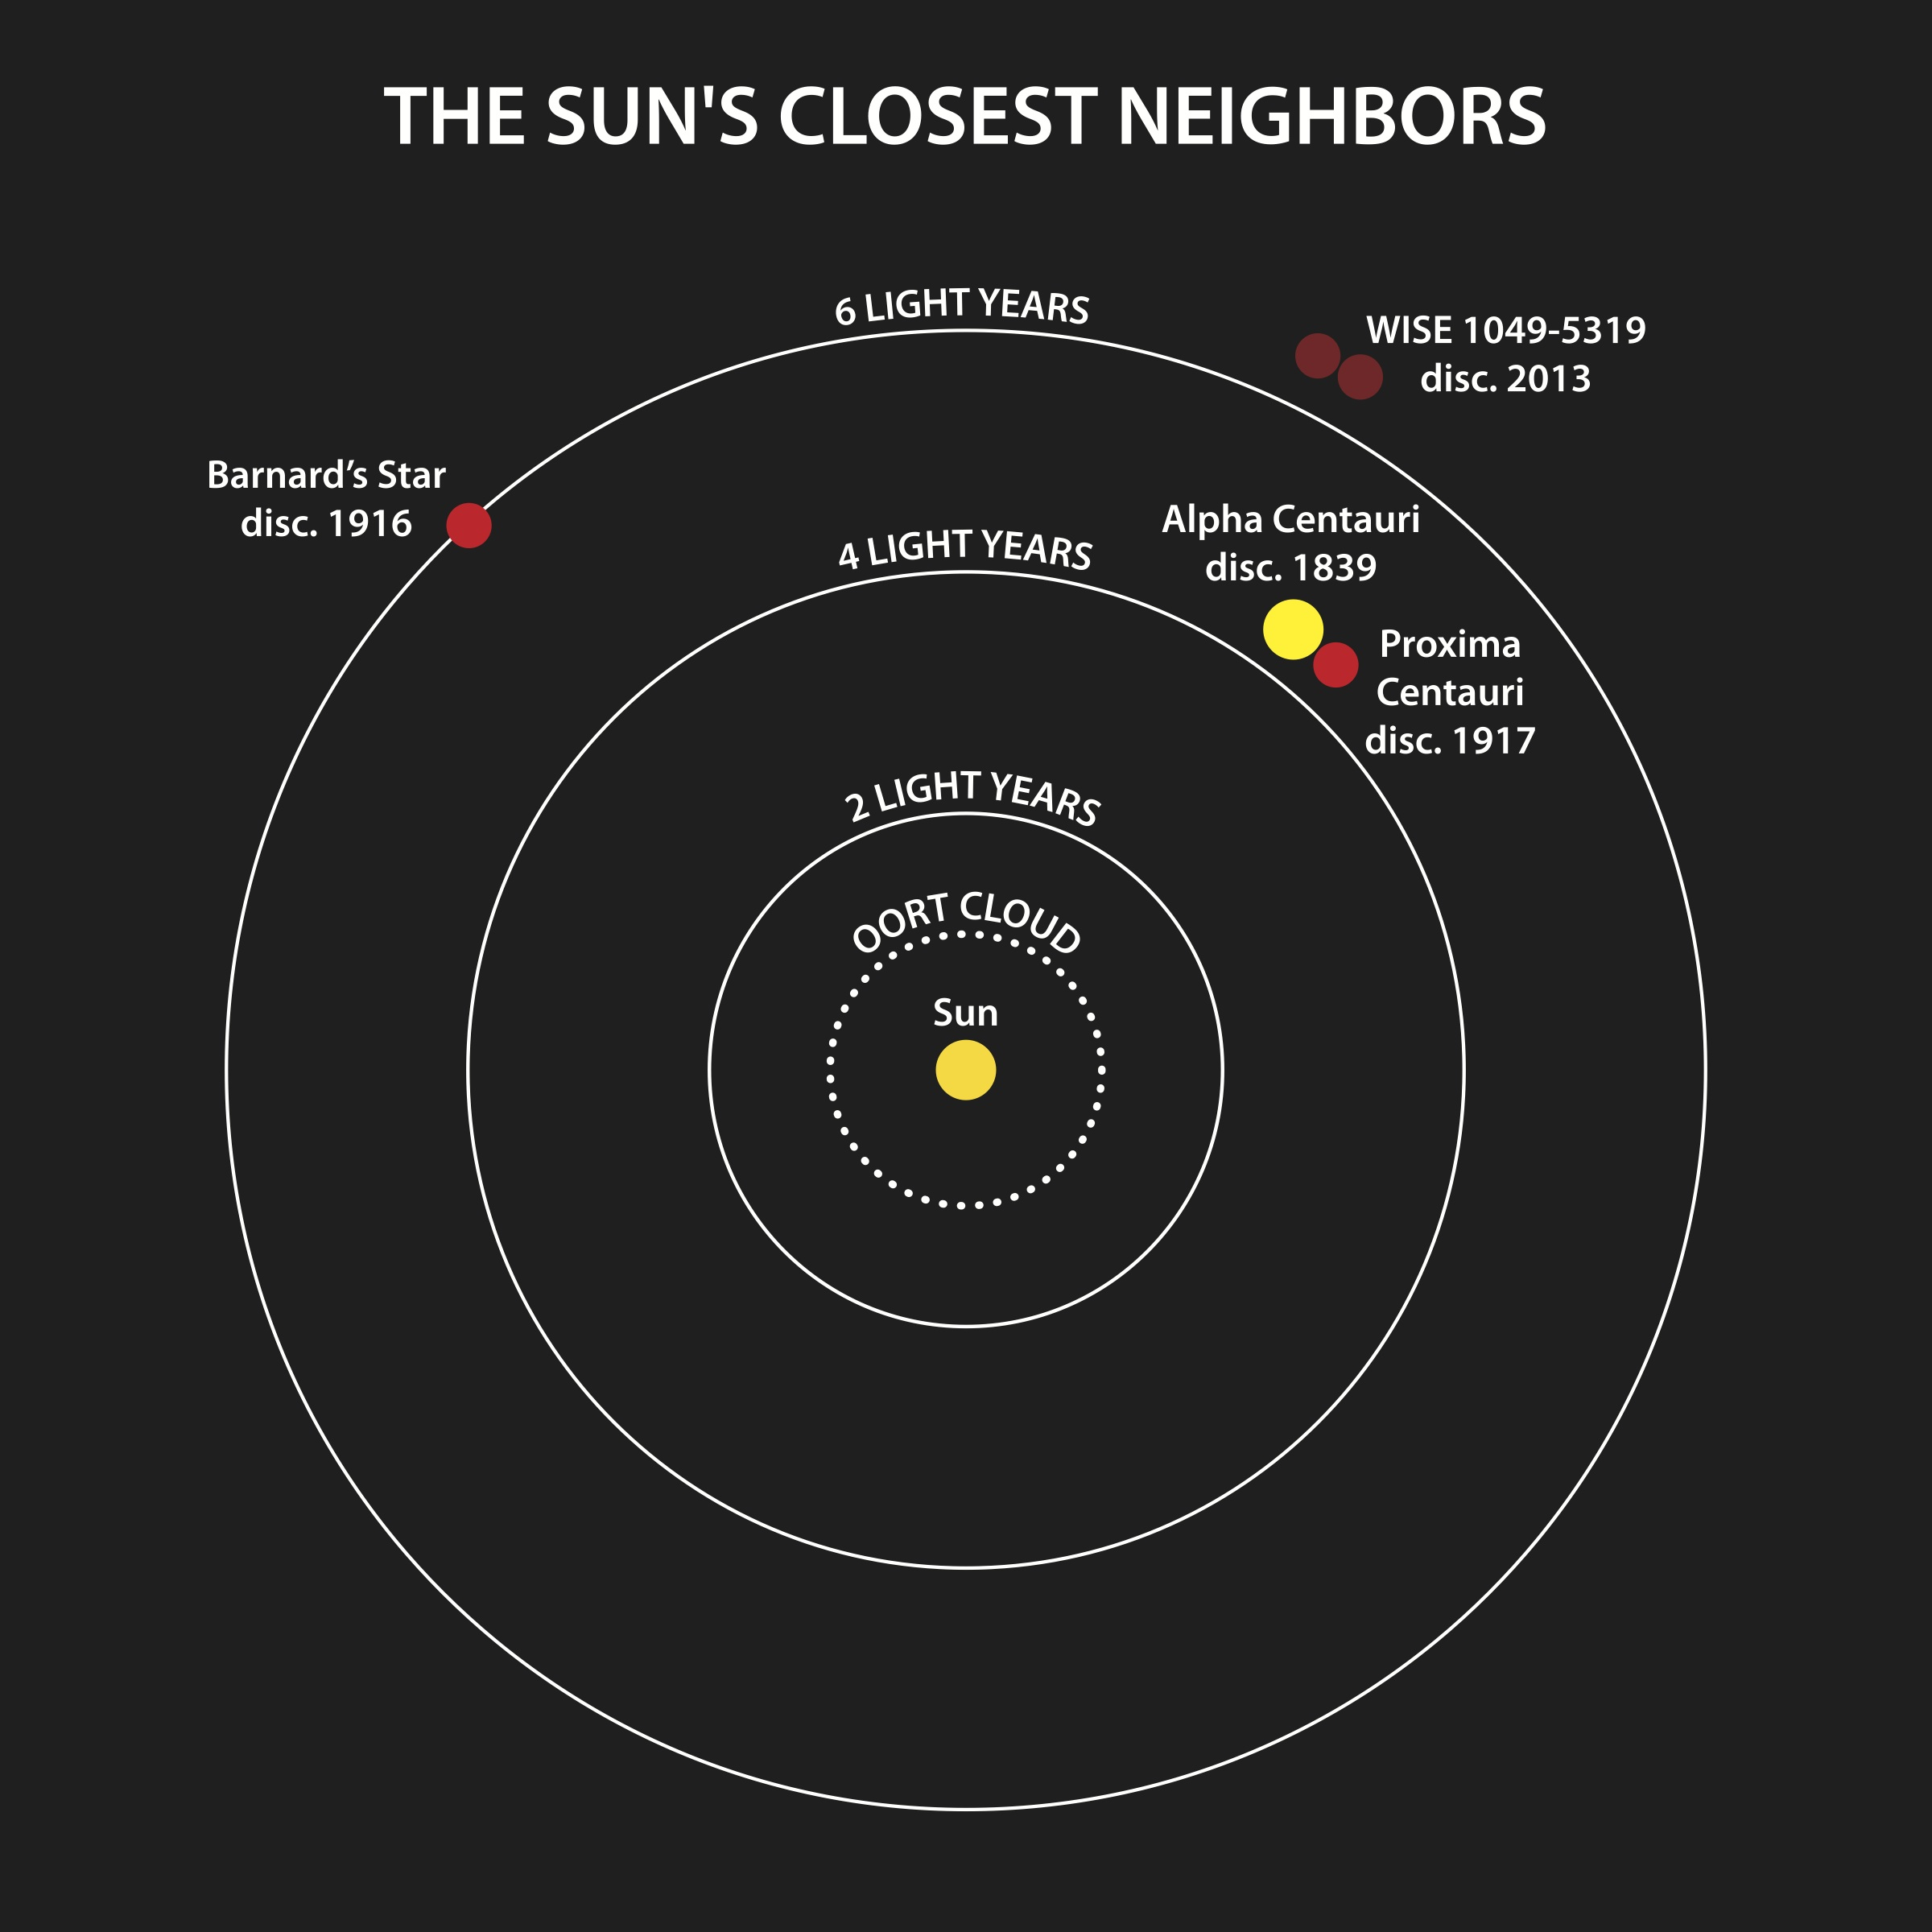
Our Sun
Sun
The sun is a medium sized star.
The sun is also a relatively cool star at about 5,500 C on its surface.
The next closest star is Proxima Centauri and is 270,000 times farther away from Earth than the sun is.

Slide 7
Star Clusters
The smallest space structure is a solar system.
Next largest is a star cluster
A group of stars bound together by gravitational attraction
Star clusters may contain a couple hundred to thousands of stars.
The next largest is a galaxy.

Slide 8
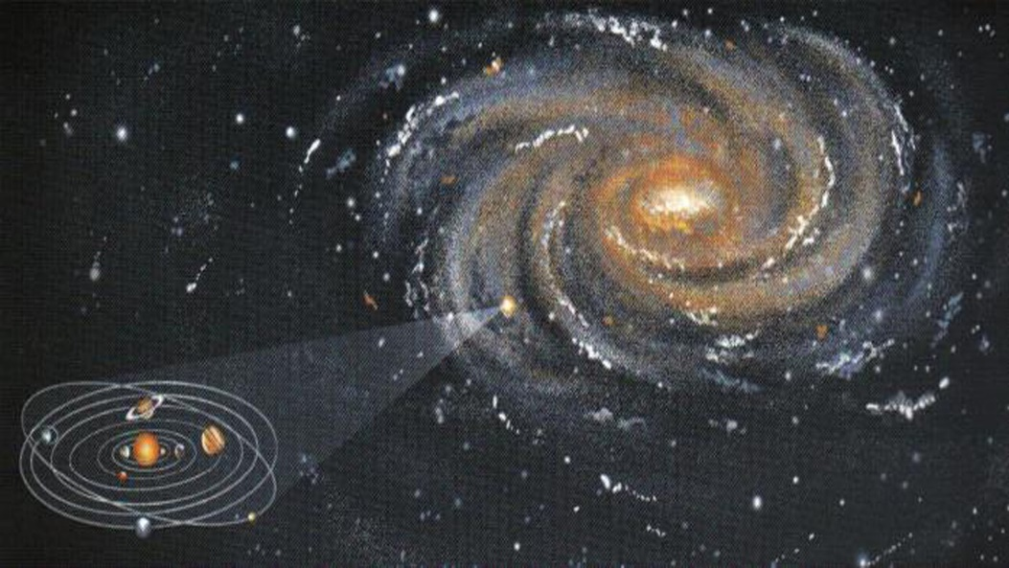
Galaxy
Our solar system is located in outer arm or the edge of the Milky Way Galaxy.
The Milky Way Galaxy is a single star spiral galaxy.
Other types of galaxies include
Elliptical galaxies
Look like spheres with no “arms”
Irregular galaxies
No pattern blobs
These are very active areas for star formation

Slide 9
The Universe
The universe can be defined as space and all the matter and energy in it.
Within the universe there are clusters of galaxies called super clusters
These super clusters may contain several thousand galaxies
There are also large areas where very little matter exists called voids.
The structure looks like a spider web.
web = clusters
Space between web = voids

Slide 10
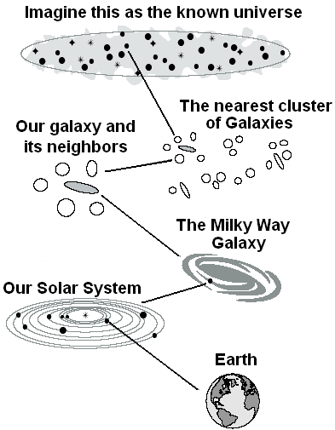

Slide 11
Closing Questions:
Answer the following questions on your closing section on the warm up using complete sentences:
How could you describe your location in space?
What are three new things you learned today?
What are three things you still want to know about space?

