Slide 1
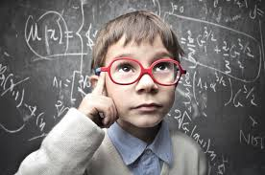
Theory!
A theory is an idea used to explain a situation or justify an outcome.
Theories are ideas that are backed up by facts.
Scientists usually agree upon theories.
Theories can change.

Slide 2
Current Theory!
Scientists currently believe that our universe is approximately 10 to 15 billion years old.
There have been many theories over the years to explain the formation of the universe.

Slide 3
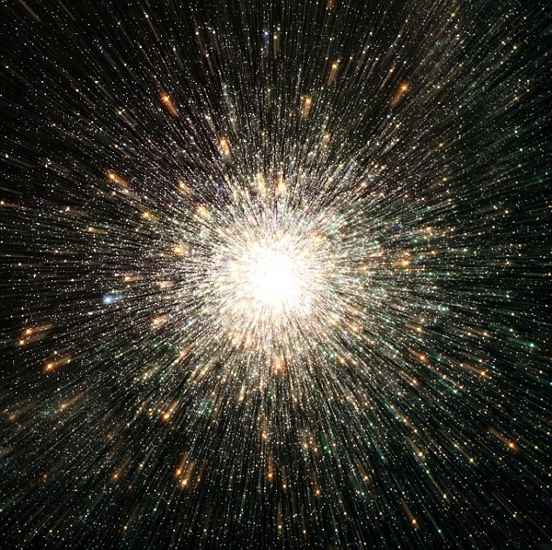
Big Bang Theory!
Scientists currently use the Big Bang Theory to explain the formation of the universe.
The largest piece of evidence that supports the Big Bang Theory is the observation that most galaxies are moving away from each other.

Slide 4
Other Space Theories
Another theory which has changed over centuries is the scientific model of our solar system.
How is our solar system organized?

Slide 5
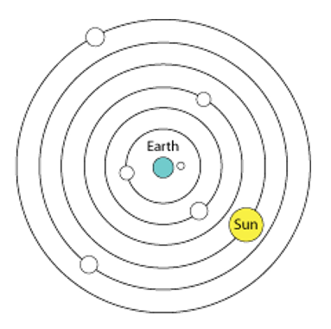
Ptolemy’s Model of The Solar System
Ptolemy’s theory is known as the Geocentric Model.
He believed that the Earth was at the center of the universe.
“geo” is the prefix for Earth
“centric” is the suffix for center.

Slide 6
Evidence for the Geocentric Model
Gravity pulled all items toward the center of the Earth.
There for the Earth must be the center.
When objects were thrown up in the air they landed in the same place.
If Earth was moving the object would fall in a different place.
We now know this theory is false.

Slide 7
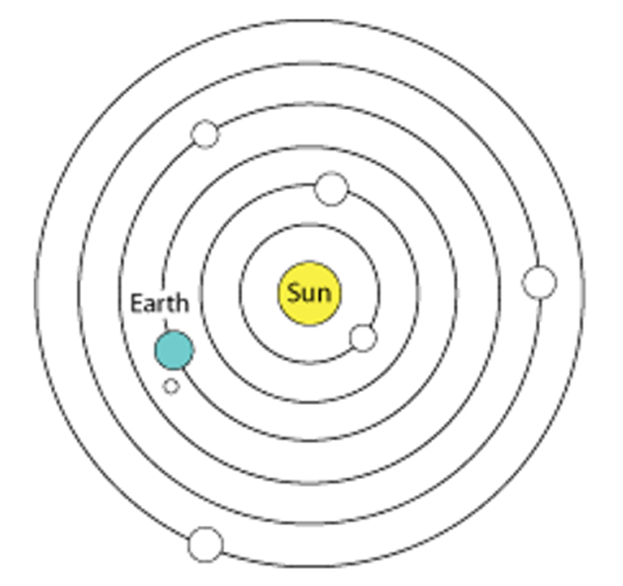
Copernicus’ Model of The Solar System
Copernicus’ theory is known as the Heliocentric Model.
He believed that the Sun was at the center of the solar system.
“helio” is the prefix for Sun
“centric” is the suffix for center.

Slide 8
Evidence for The Heliocentric Model
Galileo made observations using telescopes to support Copernicus’ theory.
Galileo observed Venus had “phases” like the moon.
This can only be explained if Venus is also orbiting the Sun.

